Slide 1


Major Project
Title: Diabetes Prediction
and
Medicine Recommendation
Presented by:
Name | Roll No. | Branch
Nandini Srivastava | 271223145 | MCA (Data Science)
Tejendra Kumar Panda | 271223158 | MCA (Data Science)
Abhishek Choudhary | 271223153 | MCA (Data Science)
Ashish Kumar | 271223152 | MCA (Data Science)
Mentored By :
Mr. Mrinal Maji

Slide 2
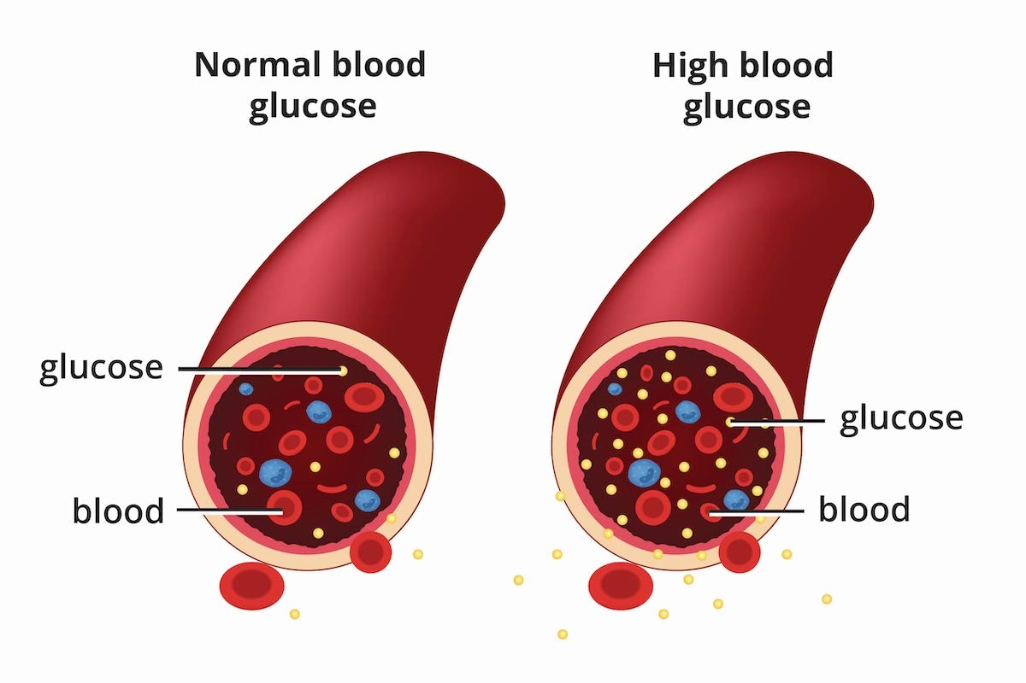
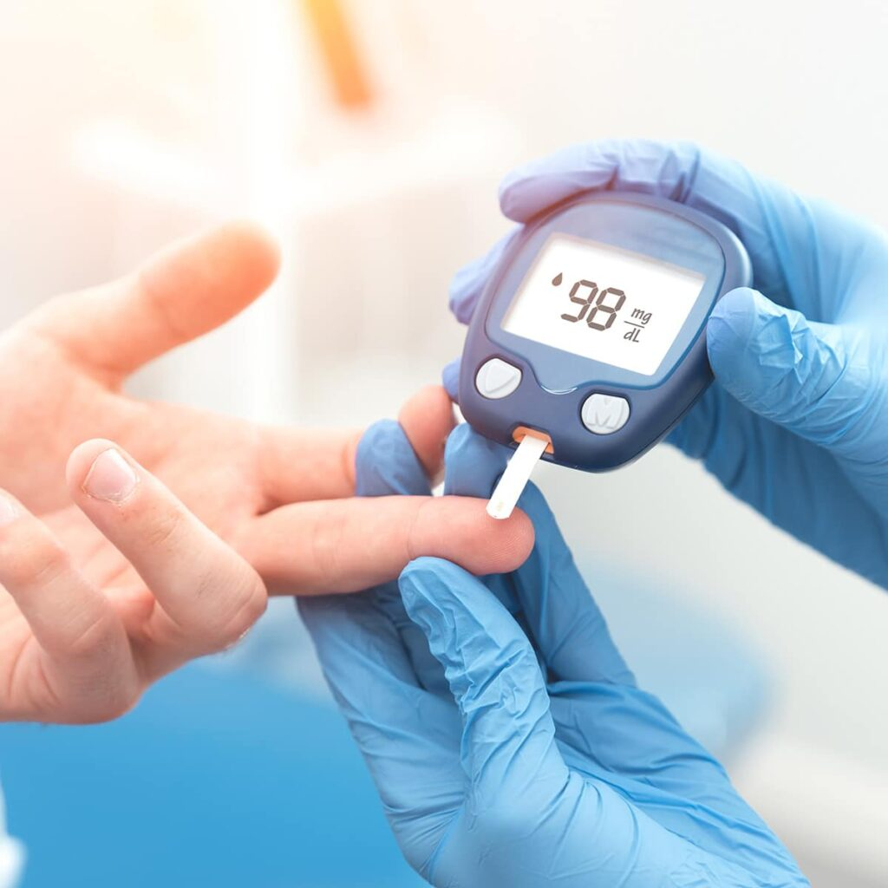
Content
Introduction
Literature Review
Objectives
Methodology
Working Model
Results
Conclusion
References

Slide 3
Introduction
Introduction to Diabetes Prediction And Medicine Recommendation
Introduction to Diabetes:
Diabetes is a chronic condition that affects millions of people worldwide.
Early diagnosis and proper management are crucial to prevent complications.
Predicting diabetes using machine learning models can significantly improve the accuracy and speed of diagnosis.

Slide 4
Challenges in Manual Diagnosis:
Traditional diagnostic methods involve manual review of patient data (blood tests, medical history).
Challenges include:
Time-consuming manual inspections.
Risk of human error in evaluating test results and symptoms.
Limited ability to process large volumes of patient data efficiently.
Need for more accurate, efficient, and automated systems.

Slide 5
Machine Learning Approach:
Objective: Build models using machine learning algorithms to predict diabetes and recommend medicines.
Features used for prediction: Pregnancies, Glucose, Blood Pressure, Skin Thickness, Insulin, BMI, Diabetes Pedigree Function, Age.
Models used:
Support Vector Machine (SVM)
Random Forest Classifier
Logistic Regression
CatBoost Classifier
These models provide early and accurate detection, reducing diagnostic time and improving treatment outcomes.

Slide 6
Literature Review

Slide 8
Objective
Early and Accurate Detection: Develop a model that analyzes healthcare data or ultrasound images to detect and classify thyroid abnormalities.
Focus: Detect nodules, cysts, and other irregularities early on.
Benefit: Aids in timely and precise diagnosis, allowing for better treatment planning.
2. Enhanced Diagnostic Efficiency: Implement an automated system to support radiologists in diagnosing thyroid disorders.
Focus: Reduce manual analysis time and improve diagnostic consistency.
Benefit: Minimizes human error and accelerates the diagnostic process.

Slide 9
Methodology
Data Collection: Collect relevant healthcare data from patients, such as medical history, blood tests, and demographic details. Ensure the dataset includes both diabetic and non-diabetic cases, with proper labeling for accurate model training.
Data Preprocessing: Clean the data by removing missing or inconsistent values and normalize numerical features to ensure consistency. Apply techniques like oversampling or undersampling to handle imbalanced data for better model performance.
Feature Extraction: Identify key features from the dataset, such as glucose levels, blood pressure, BMI, and insulin levels. Use feature engineering techniques to enhance the dataset's predictive power or leverage automated feature extraction through deep learning models.
Model Selection: Choose machine learning models, such as SVM, Random Forest, Logistic Regression, or deep learning models for diabetes prediction. Select models based on performance in early experiments.

Slide 10
5. Model Training and Validation: Split the dataset into training, validation, and testing sets. Train the models using the training data, fine-tune hyperparameters using the validation set, and measure performance through cross-validation techniques.
6. Model Evaluation: Evaluate the models using metrics such as accuracy, precision, recall, and F1 score. Analyze the ROC-AUC curve to determine the model's diagnostic effectiveness, ensuring robustness across various cases.
7. Model Deployment: Deploy the trained model into a healthcare system, allowing real-time predictions of diabetes risk. Integrate a medicine recommendation system based on patient profiles and clinical guidelines.
8. Continuous Monitoring and Improvement: Monitor the model’s performance post-deployment by collecting feedback and assessing real-world data. Regularly update the model using new patient data to improve accuracy and effectiveness in predicting diabetes and suggesting appropriate medication.

Slide 11
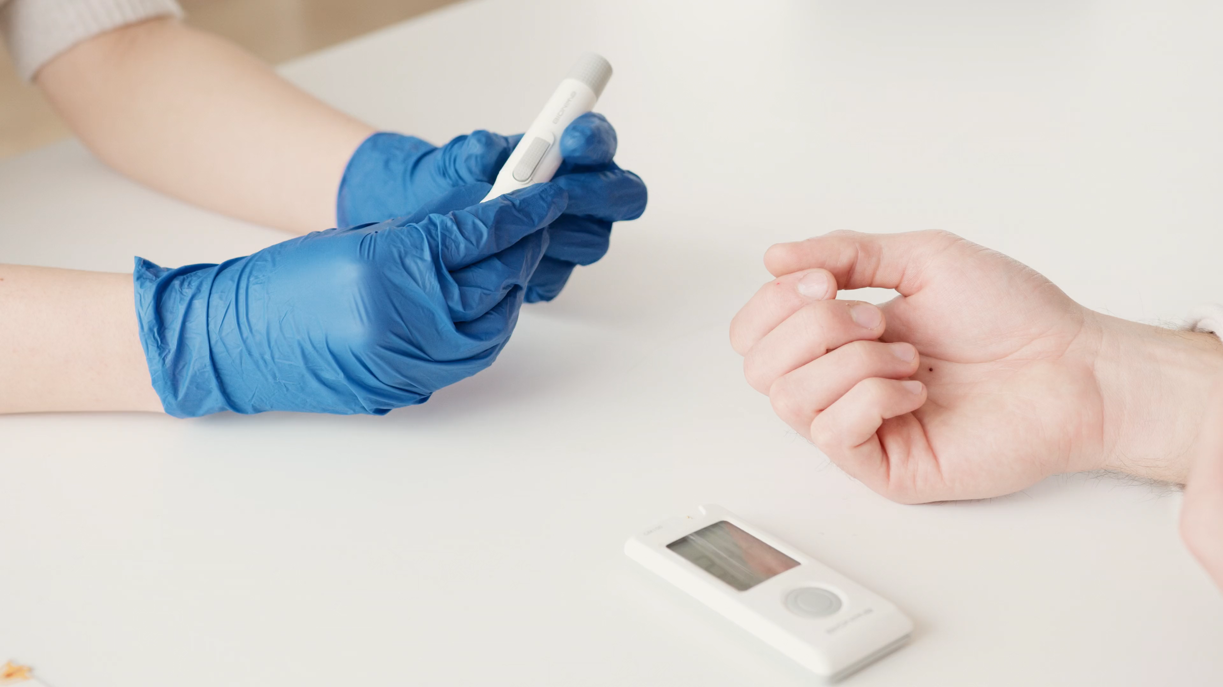
Diabetes Prediction and Medicine Recommendation
Dataset
Dataset Name: Diabetes Dataset
Source: Kaggle (diabetes.csv)
Size: Training Instances: 2800
Test Instances: 972
Attributes: 8 features including:
Pregnancies
Glucose
Blood Pressure
Skin Thickness
Insulin
BMI (Body Mass Index)
Diabetes Pedigree Function
Age
Outcome Variable:
0 = Non-Diabetic
1 = Diabetic
Dataset link: https://www.kaggle.com/datasets/mathchi/diabetes-data-set?resource=download
Notebook Link:
https://colab.research.google.com/drive/1BUy91de-MieafwLHyGdAuPJHkzg6PEbe?usp=sharing

Slide 12
Diabetes Prediction and Medicine Recommendation
Dataset
Key Characteristics:
Data Types: Continuous and Boolean attributes.
Missing Values: Presence of missing data in several attributes, requiring preprocessing.
Statistical Summary: Mean, median, and other descriptive statistics to be analyzed.
Example Data Points:
Pregnancies | Glucose | Blood Pressure | Skin Thickness | Insulin | BMI | Diabetes Pedigree Function | Age | Outcome
6 | 148 | 72 | 35 | 0 | 33.6 | 0.627 | 50 | 1
1 | 85 | 66 | 29 | 0 | 26.6 | 0.351 | 31 | 0
... | ... | ... | ... | ... | ... | ... | ... | ...

Slide 13
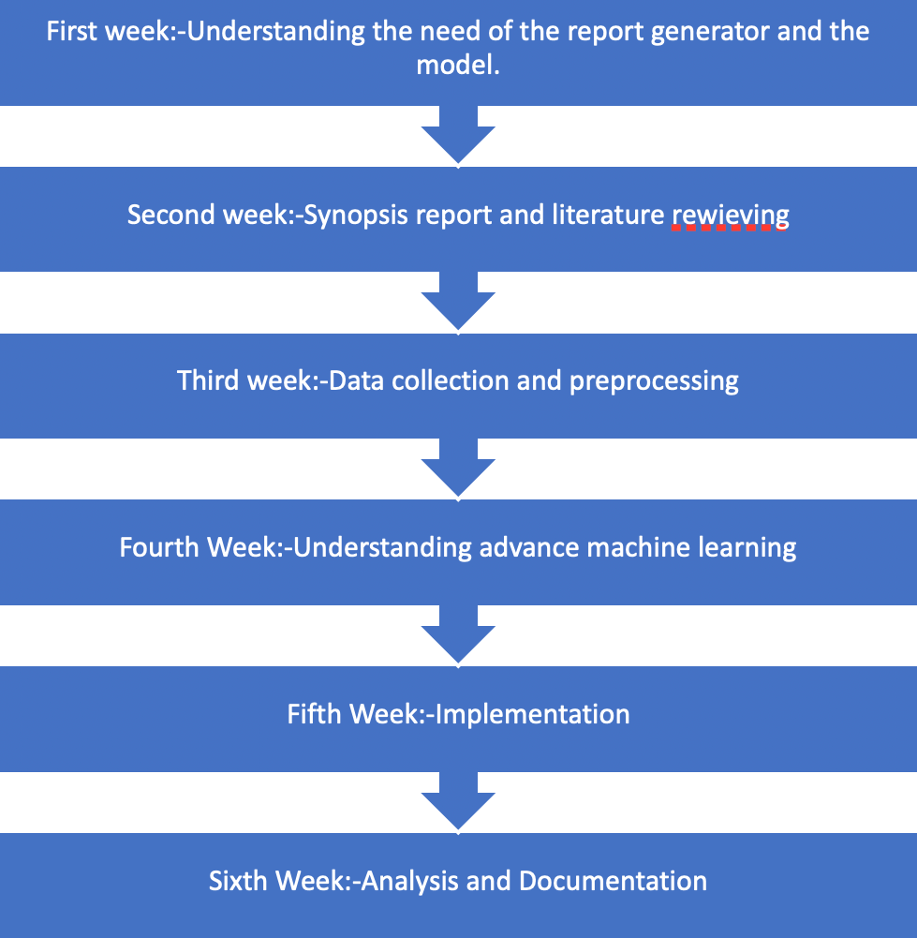
Timeline
reviewing

Slide 14
Model Architecture
Start
Data Gathering
Data Preprocessing
Model Design
Model Implementation
Model Training
HyperParameter Tuning
Model Evaluation
Model Deployment
User Interface Design
Model Monitoring
Model Maintenance and Updates
End

Slide 15
Progress Till Mid Term
Inference From Literature
Sub Objective
Deliverable of each steps or phase
Working Module
Technical Diagram
Machine Learning Models and Outputs
Attained Deliverable

Slide 16
Inference From Literature
Kim et al. (2023): This study compared various machine learning models for predicting undiagnosed diabetes. It found that machine learning models significantly outperformed traditional statistical approaches, achieving an AUC of 0.819 compared to 0.765 for traditional models, indicating a more effective method for risk assessment.
Khanam et al. (2023): The authors introduced a diabetes prediction model utilizing Boruta feature selection. Their approach achieved up to 98% accuracy on the PIMA diabetes dataset, highlighting the critical role of feature selection and data preprocessing in enhancing model performance.
Wu et al. (2022): The study evaluated five machine learning models, including CATBoost and XGBoost, using NHANES lifestyle data. CATBoost achieved the highest performance with an AUC of 0.83 and accuracy of 82.1%, underscoring the potential of lifestyle-related variables in diabetes prediction.
Rahman et al. (2023): This paper presented a diabetes prediction system using various machine learning techniques on a private dataset from female patients in Bangladesh. The findings indicated effective prediction capabilities through semi-supervised learning approaches, showcasing the adaptability of machine learning in healthcare applications for diabetes management.
Overall Findings:
Machine learning models consistently outperform traditional statistical methods in predicting diabetes.
Feature selection and data preprocessing are crucial for improving model accuracy.
Advanced models may require more data and computational resources but can significantly enhance predictive capabilities.
The choice of model should balance complexity with available resources for optimal performance.

Slide 17
Sub Objective
Feature Extraction: Identify key features in the diabetes dataset that are indicative of diabetes risk, including factors such as glucose levels, BMI, insulin levels, and family history.
Model Development: Create and optimize a machine learning model for accurate classification of diabetes status (diabetic vs. non-diabetic) using various algorithms such as Logistic Regression, Random Forest, and CatBoost.
System Integration: Develop an automated tool that integrates seamlessly into healthcare providers’ workflows to facilitate real-time diabetes risk assessment and medicine recommendations based on patient data.
Validation: Test the developed model on independent datasets to ensure its accuracy, reliability, and generalizability across different populations.
User Training: Provide comprehensive training and support for healthcare professionals to effectively use the system, interpret results, and make informed decisions regarding patient care.

Slide 18
Deliverable of Each Steps or Phases
Data Collection: Acquired a comprehensive dataset containing health metrics from diabetic and non-diabetic patients.
Data Preprocessing: Completed cleaning, normalization, and standardization of the dataset to improve model accuracy.
Model Selection and Training: Trained multiple machine learning models including SVM, Random Forest, Logistic Regression, and CatBoost for diabetes classification.
Model Evaluation: Evaluated models using accuracy metrics and determined the best-performing models for deployment.
Medicine Recommendation System: Implemented logic for medication recommendations based on diabetes severity.

Slide 19
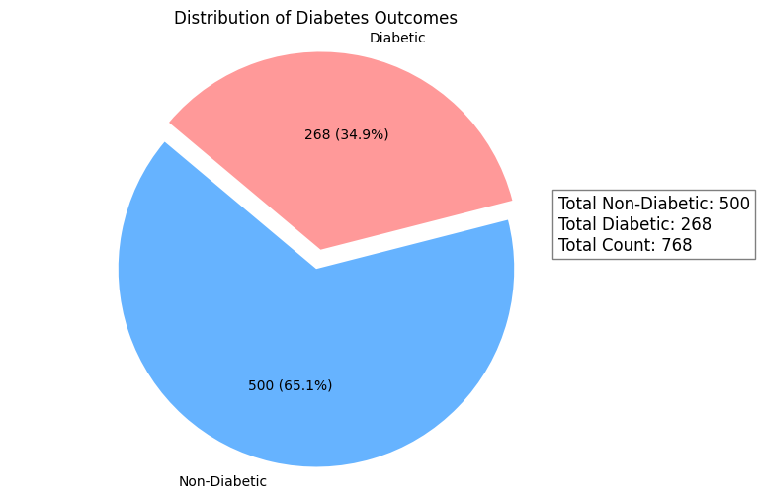
Total Number of Diabetic and Non Diabetic Values

Slide 20
Working Module
Start
Data Gathering
Data Preprocessing
Model Design
Model Implementation
Model Training
HyperParameter Tuning
Model Evaluation
Model Deployment
User Interface Design
Model Monitoring
Model Maintenance and Updates
End

Slide 21
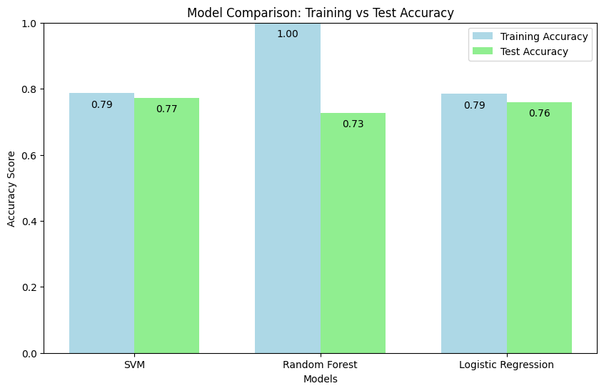
Model Comparison: Training vs Test Accuracy

Slide 22
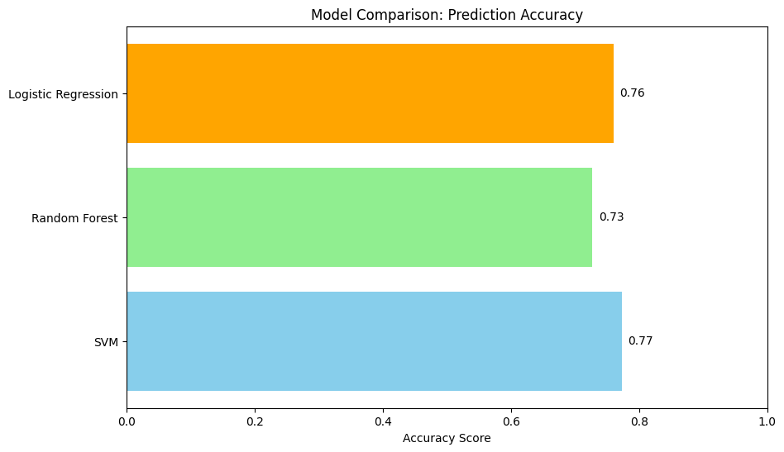
Model Comparison: Prediction Accuracy
Various machine learning models were employed:
SVM achieved an accuracy of 77% on test data.
Random Forest achieved an accuracy of 73% on test data.
Logistic Regression achieved an accuracy of 76% on test data.

Slide 23
Attained Deliverable
Trained Machine Learning Model: A fully trained Machine Learning model designed to predict diabetes outcomes based on various health parameters, demonstrating high accuracy, sensitivity, and specificity for reliable clinical use.
Web-Based Application: An intuitive web application that enables healthcare professionals to input health parameters for diabetes risk assessment, providing real-time predictions and personalized medicine recommendations.
Comprehensive Documentation: Thorough documentation that includes a user manual for effective system utilization, along with technical specifications detailing model architecture, data preprocessing techniques, and deployment requirements.
Validation Report: A detailed validation report comparing the model’s predictions with expert diagnoses, including key performance metrics such as accuracy, precision, recall, and F1 score, showcasing the model’s effectiveness in identifying diabetes risk and recommending appropriate interventions.

Slide 24
What We Will Do Till End Term
Frontend
Deploy
Medicine Recommendation
Input data
Future Scope
Paper Published

Slide 25
Conclusion
Enhanced Accuracy: The developed system leverages advanced deep learning techniques to improve the accuracy of diabetes predictions, facilitating early detection and intervention.
Informed Decision-Making: By providing reliable predictions, the system supports medical professionals in making informed decisions regarding patient care and treatment options.
Continuous Improvement: The proposed system is designed for easy updates with new data, ensuring it remains effective as medical knowledge and technology evolve.
Long-Term Utility: Its adaptability enhances long-term utility in clinical settings, providing ongoing value in diabetes management and patient health outcomes.
User-Friendly Interface: The intuitive web application allows healthcare providers to efficiently input data and receive actionable insights, streamlining the diagnostic process.

Slide 26
Reference
Mounika, K., Sridevi, K., & Prakash, A. K. (2024). Diabetes prediction using machine learning and explainable AI. NCBI. Retrieved from https://www.ncbi.nlm.nih.gov/pmc/articles/PMC10107388/
Kim, H., Lee, J., & Kim, S. (2023). Comparisons of the prediction models for undiagnosed diabetes. Scientific Reports, 13(1), 40170. Retrieved from https://www.nature.com/articles/s41598-023-40170-0
Khanam, F., Saba, T., & Hussain, M. (2023). A diabetes prediction model based on Boruta feature selection. BMC Bioinformatics, 24(1), 76. Retrieved from https://jwcn-eurasipjournals.springeropen.com/articles/10.1186/s13638-020-01765-7
Wu, Q., Huang, Y., & Wang, Z. (2022). Machine Learning Models for Data-Driven Prediction of Diabetes. NCBI. Retrieved from https://pmc.ncbi.nlm.nih.gov/articles/PMC9690067/
Rahman, M., Sultana, N., & Kadir, M. (2023). Diabetes prediction using machine learning and explainable AI. NCBI. Retrieved from https://bmcbioinformatics.biomedcentral.com/articles/10.1186/s12859-023-05300-5

Slide 27
Thank You

